Slide 1


Oil Production Forecasting
Group Number - 2

Slide 2





Meet
THE TEAM
Abhishek Boorugu
12020021
Suprateek Pande
12020023
Ajaykumar Gupta
12020009
Srilaxmi Shilpa Vutukuru
12020043
Sravya Neelamraju
12020006

Slide 3
Agenda
Business Problem and Success Criteria
Architecture Diagram
Data Collection and Pre-processing
Modelling and Evaluation
End User-Interface
Deployment
Monitoring and Maintenance
Demo

Slide 4


Business Problem and Success Criteria
Business Problem: To forecast oil production judiciously in order to meet country’s demand
Business Objective: To minimize the impact in the fluctuation of oil prices on inflation rate for US market
Success Criteria: The Impact of oil prices on the inflation rate is reduced. On comparing the forecast with actuals, the difference should be within 10-15%. A model with the lowest AIC should forecast the oil production.

Slide 5
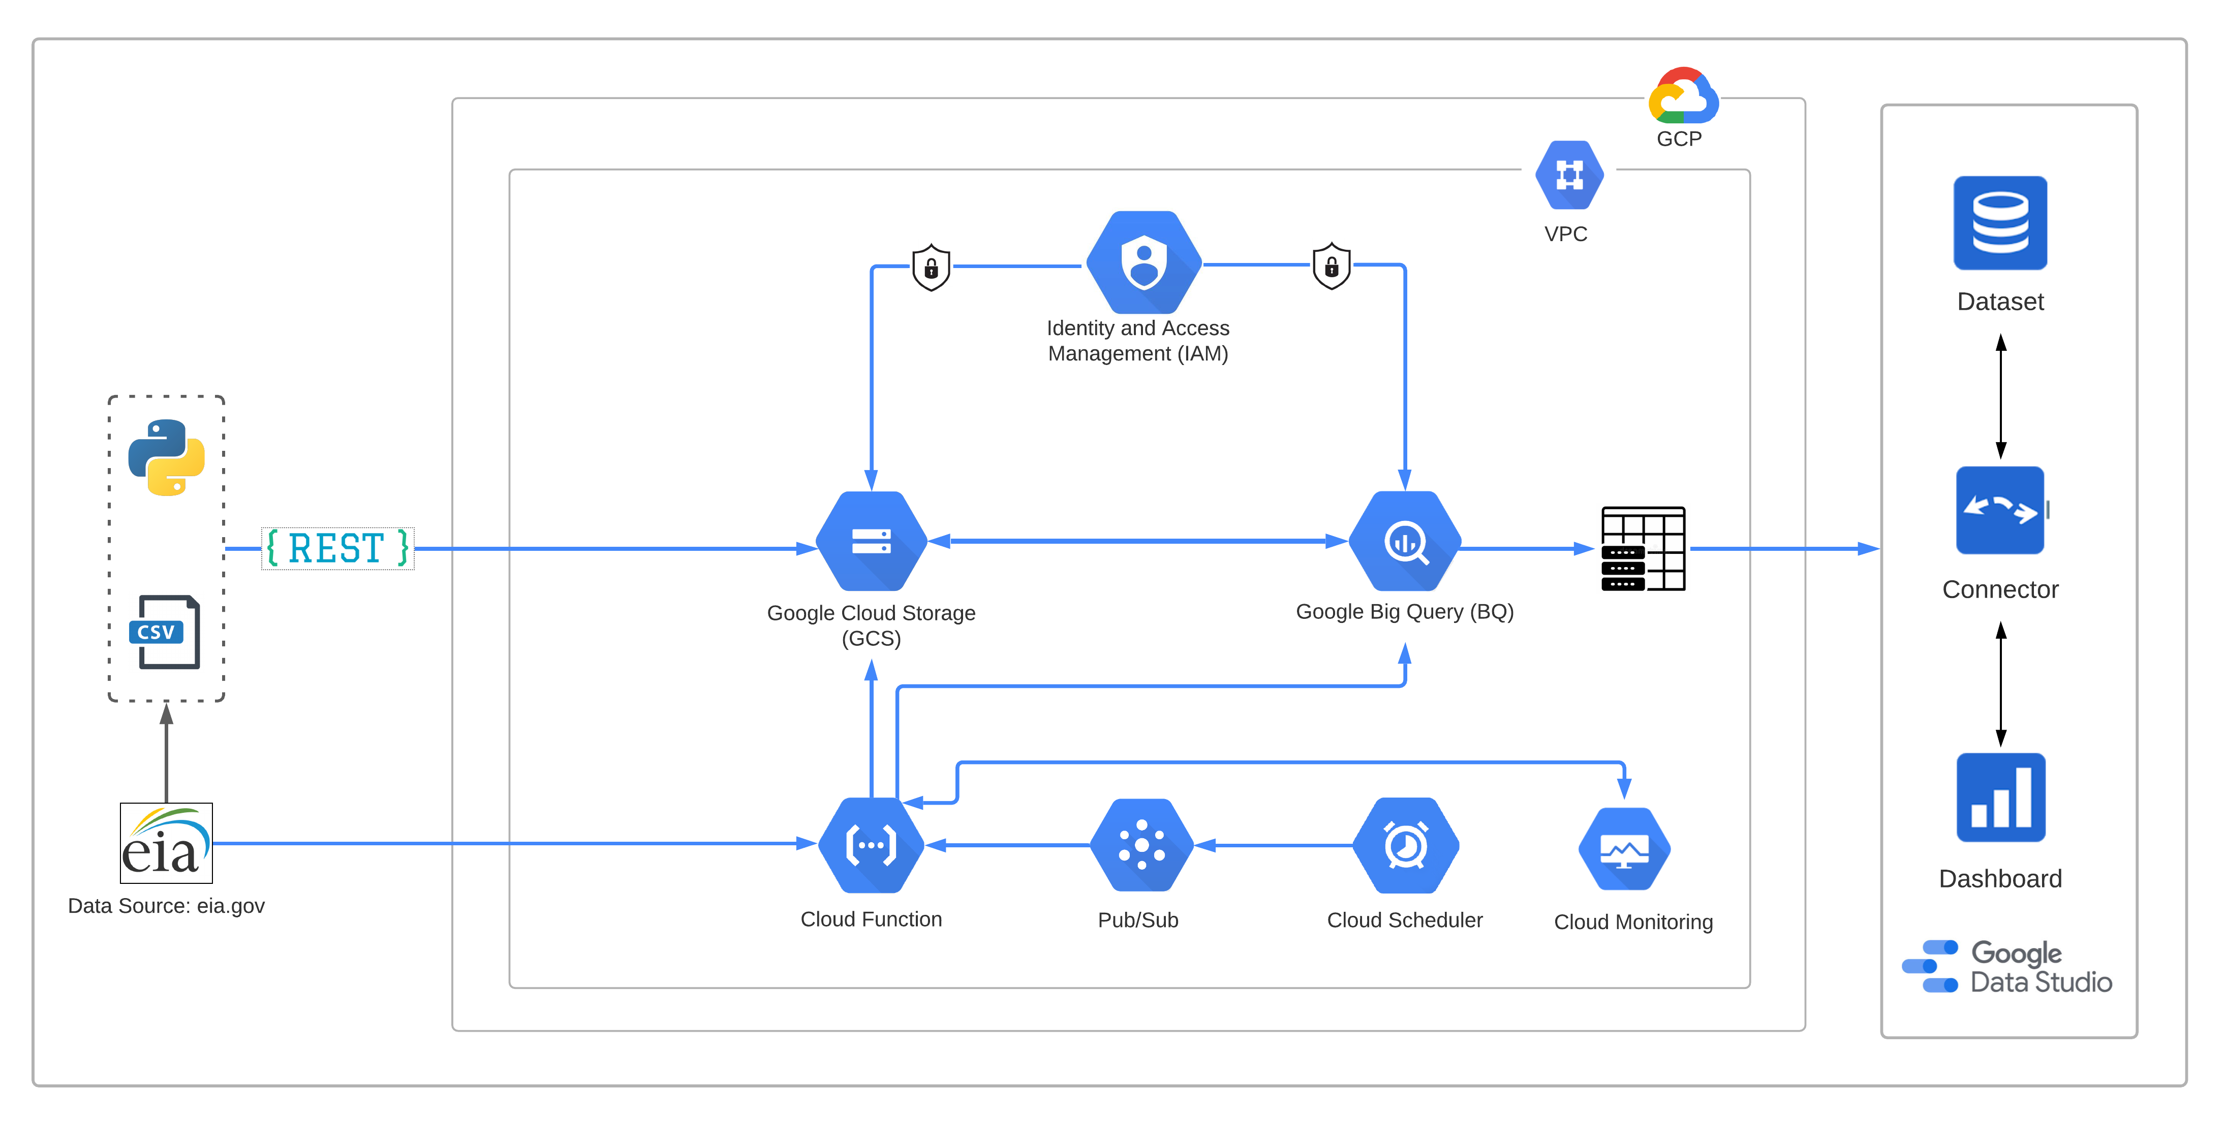
Architecture Diagram

Slide 6
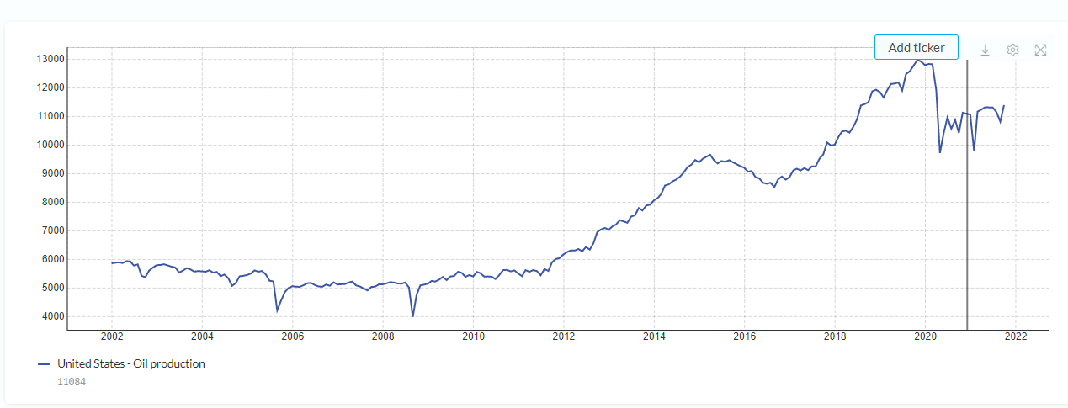
Data Collection and Pre-processing
Data Extraction - Oil Production
Website : www.eia.gov
Country : USA
Frequency : Monthly
Duration : Jan 2002 – Dec 2021
Data Pre-processing :
Transforming column fashioned data to rows
Date string to actual dates in YY-MM-DD format
Removing white spaces
Delete rows with NULL values
Handle duplicate timestamps by taking the mean
Interpolate missing data using local linear interpolation

Slide 7
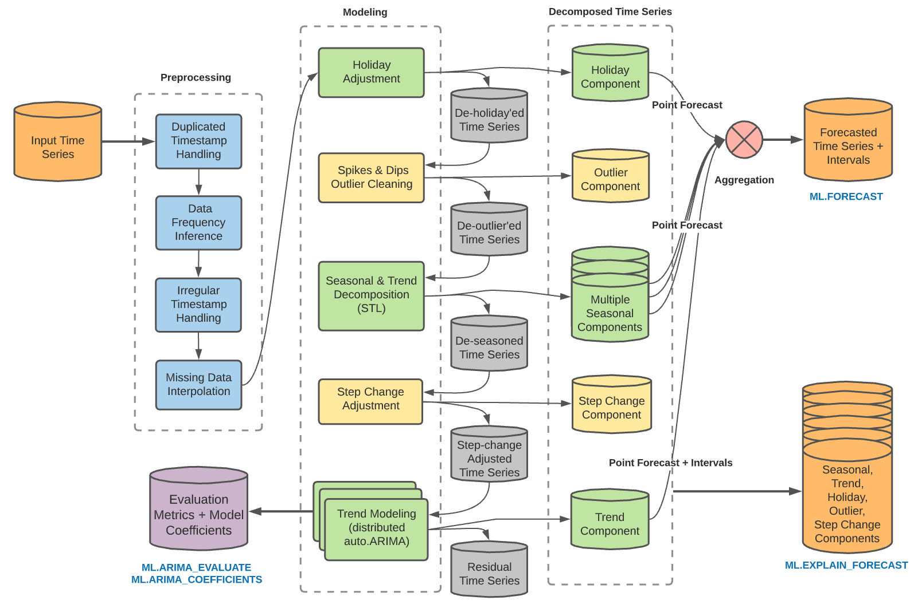
Modelling and Evaluation
Source: GCP Official Documentation
Notes:
Infer the data frequency of the time series
Detect and adjust holiday effect
Detect multiple seasonal patterns within a single time series via Seasonal and Trend decomposition using Loess (STL), and extrapolate seasonality via double exponential smoothing(ETS)
Model the trend using ARIMA model and auto.ARIMA algorithm for automatic hyperparameter tuning.
Dozens of models are trained and evaluated, and best model is considered based on lowest AIC.

Slide 8
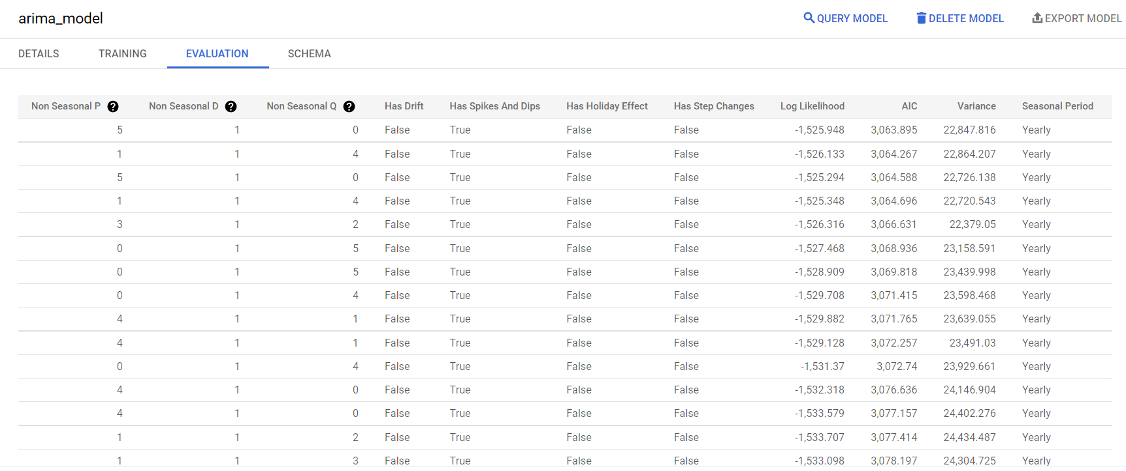
Modelling and Evaluation

Slide 9
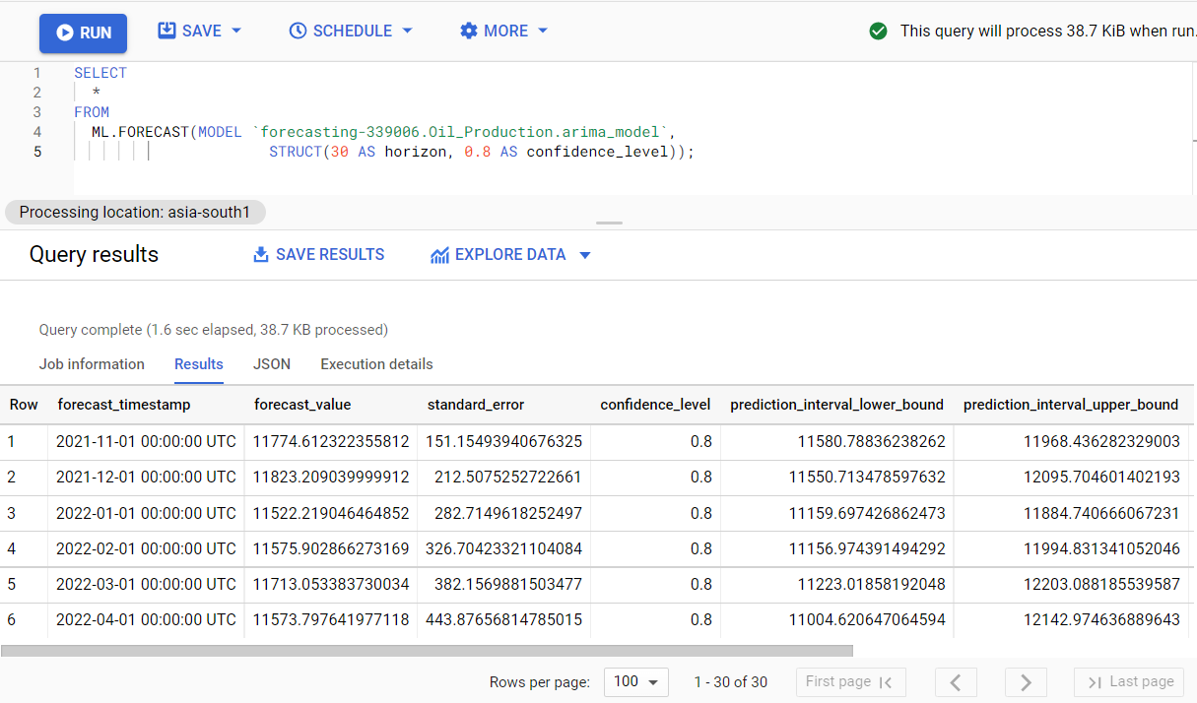
Modelling and Evaluation

Slide 10
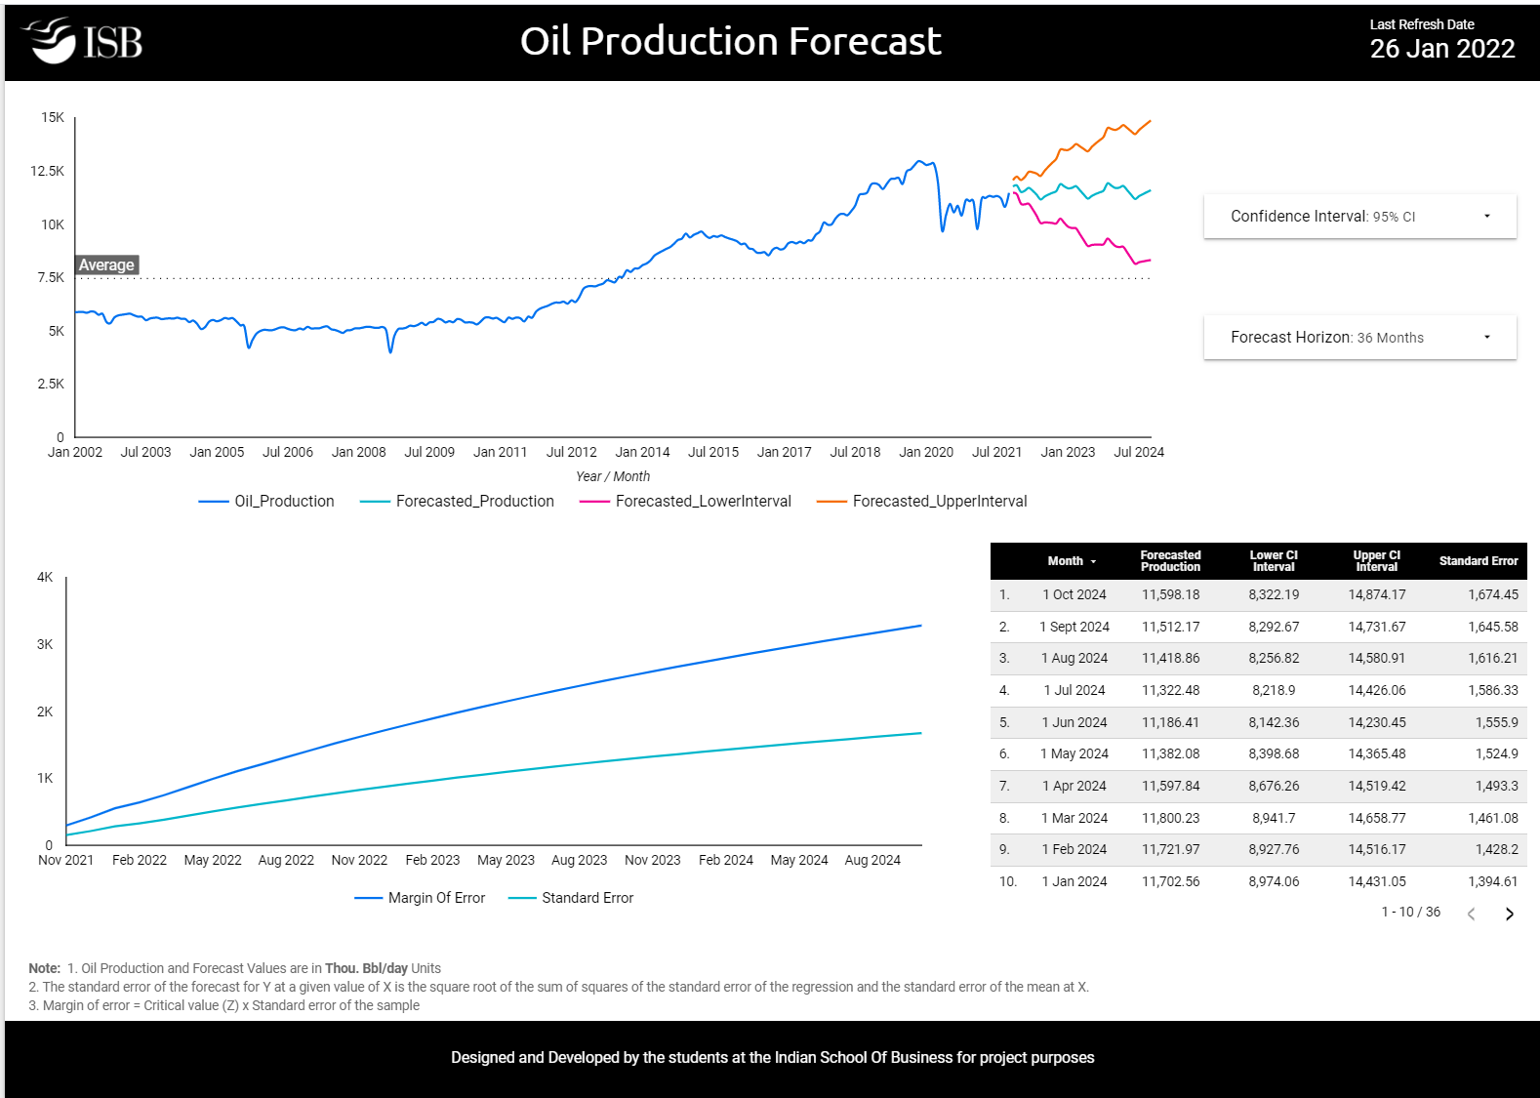
End User-Interface
An interactive dashboard built on google data studio allowing the end-user to choose from various forecast horizons and confidence levels
Margin of error and Standard error for the forecasted period
Data table showing month wise forecast numbers along with confidence intervals and standard error
https://datastudio.google.com/s/iRYPciBNIjM

Slide 11

Deployment
Fully Managed and Scalable
Built-in security controls
Easy Integration
No Infrastructure to set up and maintain
Centralized view
Effortless Scheduling
Identity and Access Management controls
Audit logs

Slide 12
Technical Specifications
Hardware Configuration
Memory 256 MB
Storage 512 MB
Linux OS
Python 3.9
Libraries used
Pandas
Numpy
Google Cloud – BigQuery
Google Cloud – Storage
Date Time
Version Control
GitHub

Slide 13
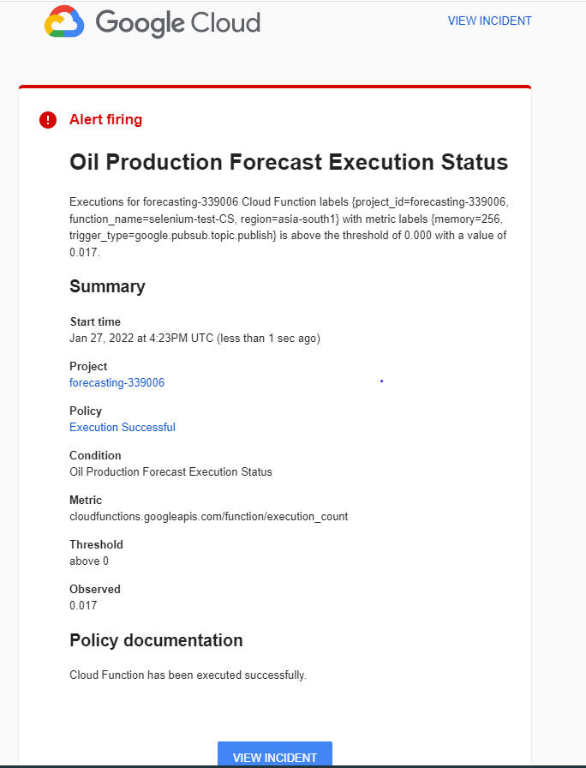
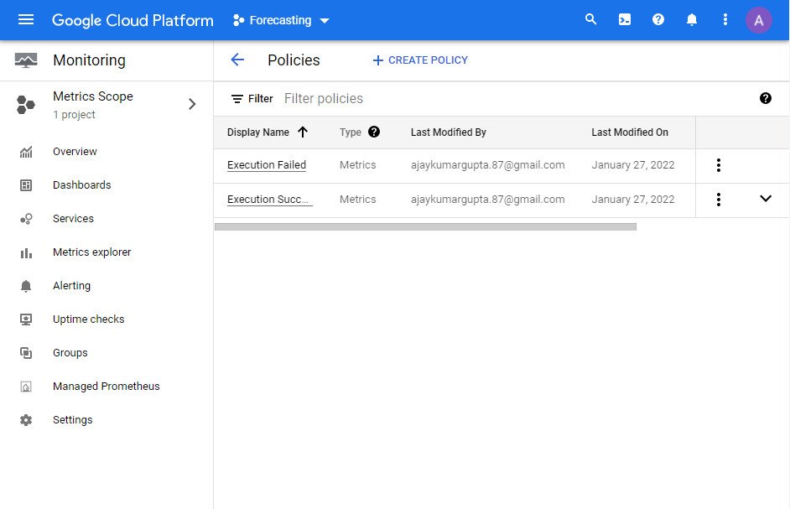
Monitoring and Maintenance
Leveraging Google Cloud Platform Monitoring service to monitor production jobs.
Email Alerts are triggered to all business stakeholder for every successful / failed events.

Slide 14
Demo

Slide 15

Thank you

Slide 17
APPENDIX

Slide 18
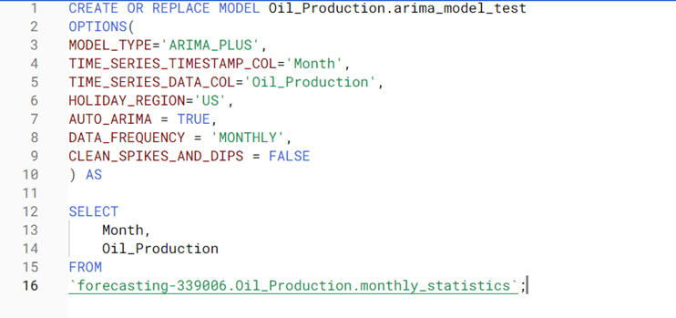
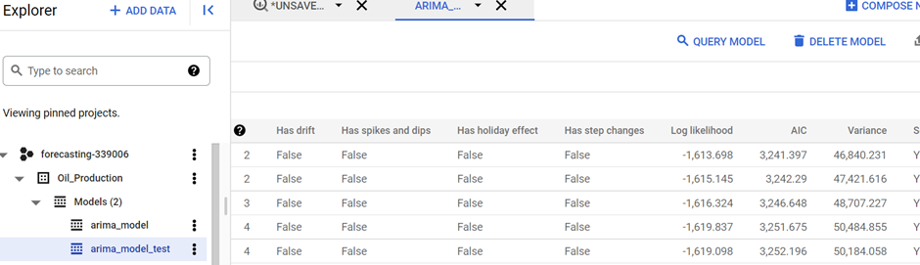
Modelling Parameters Experimentation
SPIKES = FALSE

Slide 19
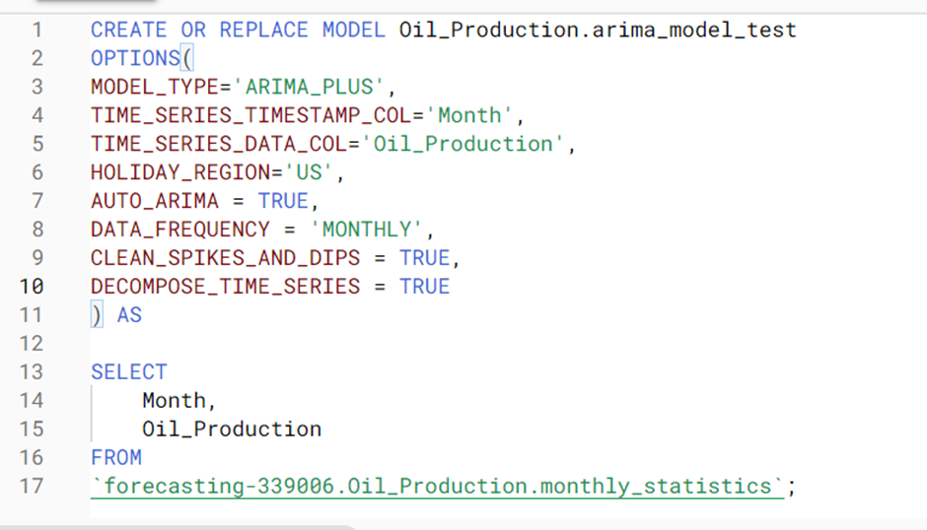
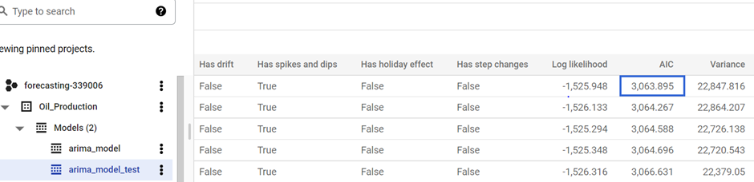
Modelling Parameters Experimentation
DECOMPOSE_TIME_SERIES = TRUE

Slide 20
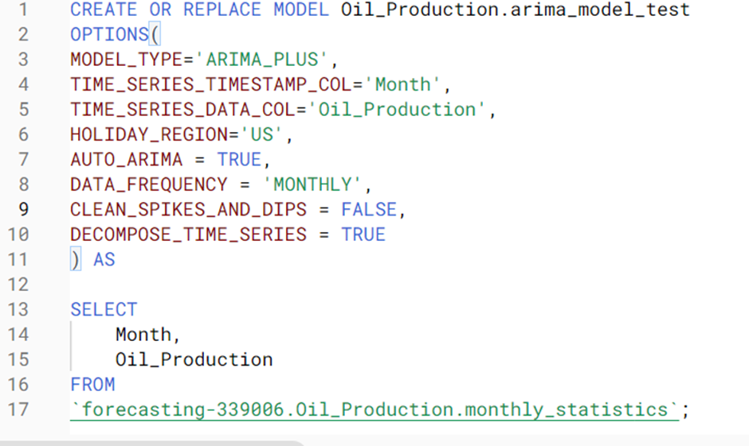
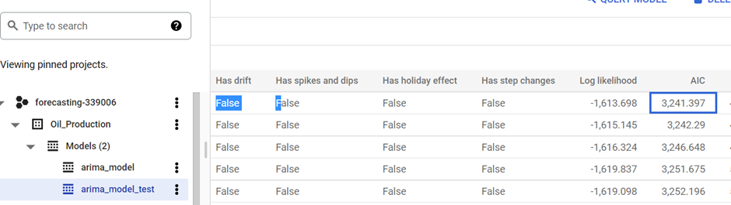
Modelling Parameters Experimentation
CLEAN_SPIKES_AND_DIPS = FALSE,
DECOMPOSE_TIME_SERIES = TRUE

Slide 21
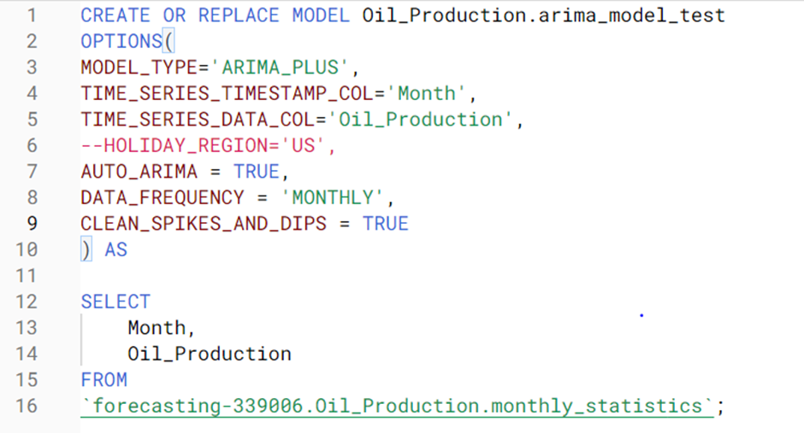
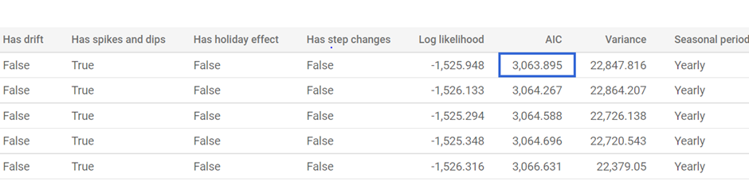
Modelling Parameters Experimentation
Without Holiday Effects

Slide 22
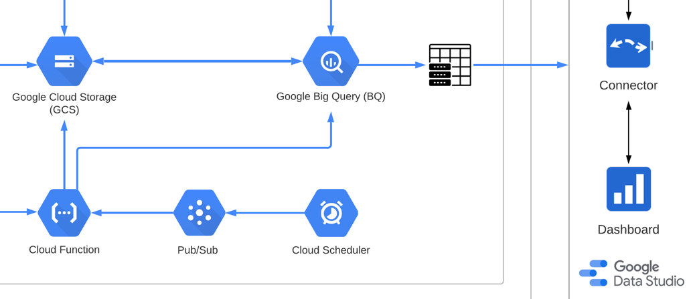
Deployment and Monitoring
Technical Stack
In our use case we have used more than one product from the Google Cloud Platform family like Cloud Scheduler, Pub/Sub, Cloud Functions (Python), Cloud Storage, BigQuery and Data Studio
Pub/Sub: Pub/Sub (Publisher / Subscriber) is used for streaming analytics and data integration pipelines to ingest and distribute data. We have used it to ingest data from econdb.com
Cloud Scheduler: A fully managed job scheduler that enables scheduled triggering of data transfer via Pub/Sub
Cloud Function: Scalable pay-as-you-go service from Google Cloud to run the code with NO server management.
Cloud Storage: Google Cloud Storage is a file storage service for storing and accessing data on Google Cloud Platform infrastructure combining the performance and scalability with advanced security and sharing capabilities.
BigQuery: BigQuery is a fully-managed, serverless data warehouse that enables scalable analysis over petabytes of data. It is a Platform as a Service that supports querying using ANSI SQL. It also has built-in machine learning capabilities.
Source: cloud.google.com

Slide 23
Deployment and Monitoring
Deployment
Create a Cloud Scheduler job to pull the monthly oil production statistics from the data source
A Pub/Sub topic was created to set as sink for the monthly data
A new Cloud Function created and the Pub/Sub topic created in the above step was chosen as the trigger
Python Code was written for the Cloud Function to write the monthly data in CSV format into Google Cloud Storage
The information is then uploaded to the Big Query table, where the Forecasting Model is generated
A BigQuery view was created combining the historic production data with the forecasting production data
Google DataStudio was used for generating the visualization of the oil production future trend

